Slide 1
Instructions
Delete this slide before presenting
Thank you for downloading this slide deck from https://www.mendeley.com/advisor-community
You should feel free to make this presentation your own - so please go ahead and customize it! Add or remove slides, add or remove notes, and perhaps add your contact information to the first slide so attendees can get in touch. Note that some slides contain animation.
If you require any of the original images included in these slides, email mendeley-community@mendeley.com.

Slide 2
Introduction To Mendeley

Slide 3

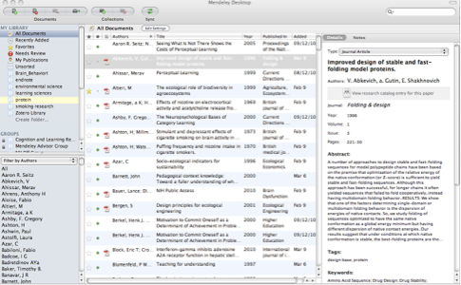
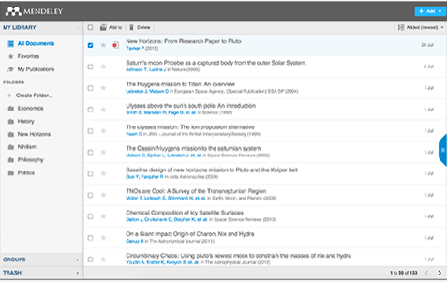
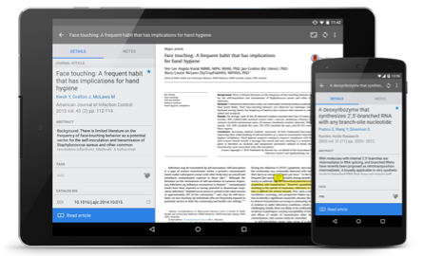
What is Mendeley?
Free Academic Software
Cross-Platform (Win/Mac/Linux/Mobile)
All Major Browsers
Desktop
Web
Mobile
Notes:
So what is Mendeley? Mendeley is free software which is available across a number of different platforms. You can run Mendeley on your computer or laptop, your phone or tablet, and also access it from any modern browser. You can either download the appropriate app for your particular device, or use your web browser to log onto the web version.
Mendeley’s Desktop application offers the most complete experience - allowing you to organize, collaborate and discover, as well as use the citation plugin to cite as you write in Microsoft Word or LibreOffice. We’ll cover this in more detail later on.
The other versions - Web and Mobile - offer you the ability to access your references on the go, as well as making notes and annotations.

Slide 4









How Does Mendeley Help?
Notes:
Mendeley acts as a repository for your reference information. You add papers to your library by importing PDF files stored on your computer, or by retrieving them from other locations - like online catalogs such as ScienceDirect, Scopus, Pubmed or PLOS. You can also create entries for items that you don’t have access to as PDFs by manually entering details.
Materials you add to your library are then stored in the cloud, for you to retrieve wherever you need them. It might be that you want to read a paper on the way home on the train, or you need to write a paper on your main computer. Mendeley allows you to retrieve the same resources with the same enhancements and annotations wherever you need them.

Slide 5
Overview:
Using Mendeley

Slide 6
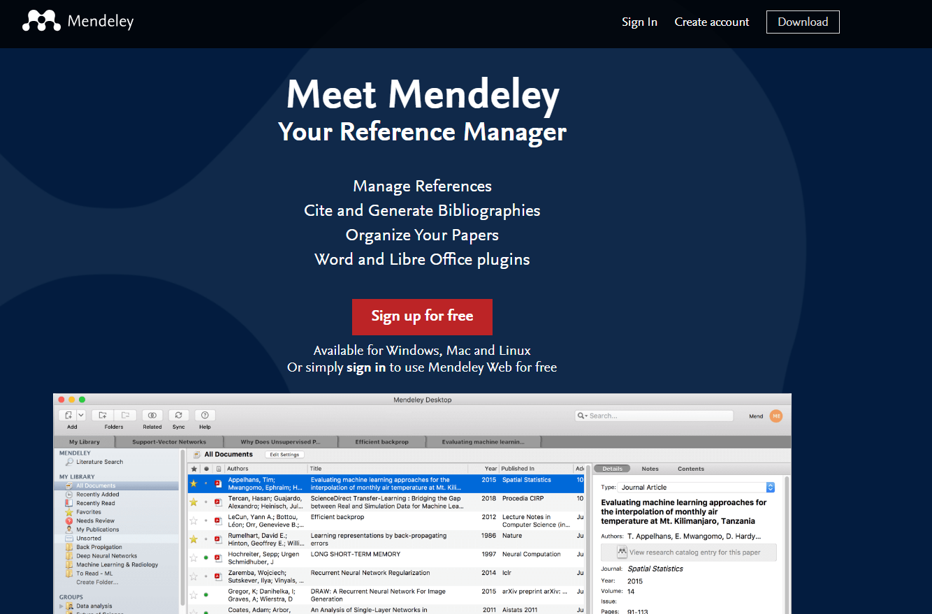
Create a free account
Notes:
The first thing you’ll need to do is to create an account via mendeley.com. This is completely free to do and only takes a few seconds. You’ll need a Mendeley account to log into the different versions of the software.
Once you’ve created your account you’ll be prompted to download the appropriate version of Mendeley Desktop for your current machine. You don’t have to do this right away, but it’s a good idea to have the desktop application installed on your main working computer.

Slide 7
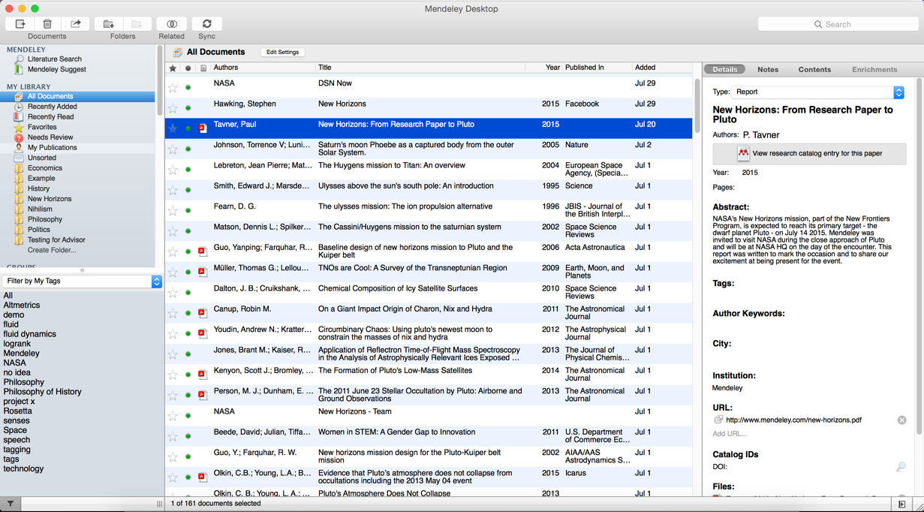
Mendeley Desktop
Notes:
This is how Mendeley Desktop looks on a Mac. The Windows version may have a few cosmetic differences, but the functionality is exactly the same. This presentation uses Mac screenshots throughout - but don’t let that put you off if you use a Windows PC.
Mendeley Desktop offers the complete Mendeley experience. It allows you to build, maintain and order your personal library. It also allows you to access reading and writing functions. We’ll go through these in more detail later.
When you first open Mendeley Desktop, you’ll need to log into your Mendeley account. This ensures that any changes you make are being made to your own account and will be carried across when you log into different devices.
Mendeley Desktop follows a three column structure. The left-hand panel allows you to navigate through different filtering options for your library. When you click on different folders or groups listed in this column, different lists of papers will be returned in the main panel. In this screenshot we have ‘All Documents’ selected, which means the main panel is listing all of our references.
The middle panel allows you to select individual references. Clicking on a reference listed here will display this document’s details in the right-hand panel. You can also select multiple papers to undertake bulk actions, such as mass deletions or additions to folders.
The right panel shows the details of your selected reference. You can also use this panel to modify the details by clicking into the individual fields. You should carefully check and correct the details displayed in this panel as ensuring accuracy here will ensure that your citations are totally correct.
We’ll go into the details of how the interface works in just a few minutes.

Slide 8
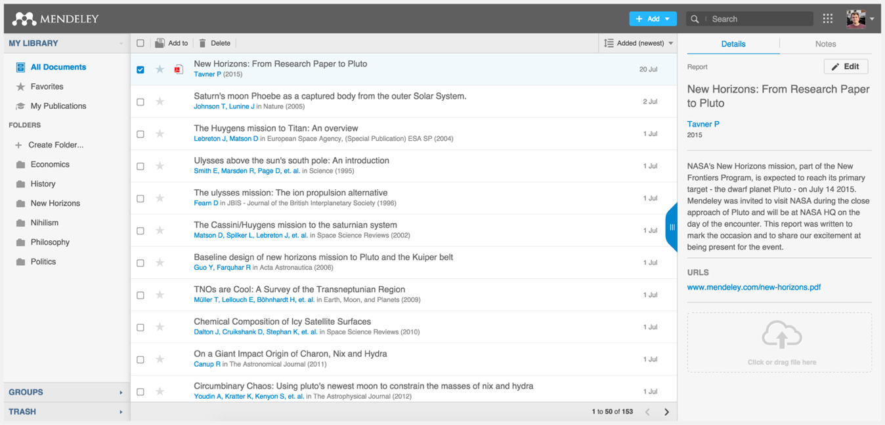
Mendeley Web
Notes:
Mendeley Web is the version of Mendeley accessible via your web browser. You’ll need to be logged into your Mendeley account in order to access it.
The layout is similar to what we’ve just seen for Mendeley Desktop - although it has been optimized for use in a browser. The same three-column structure persists. We won’t go into too much detail on Mendeley Web here - but if you’re interested in using it, there’s a dedicated guide available in the Mendeley Resource Center.

Slide 9

References and Documents

Slide 10
Organize:
Setting Up A Library

Slide 11
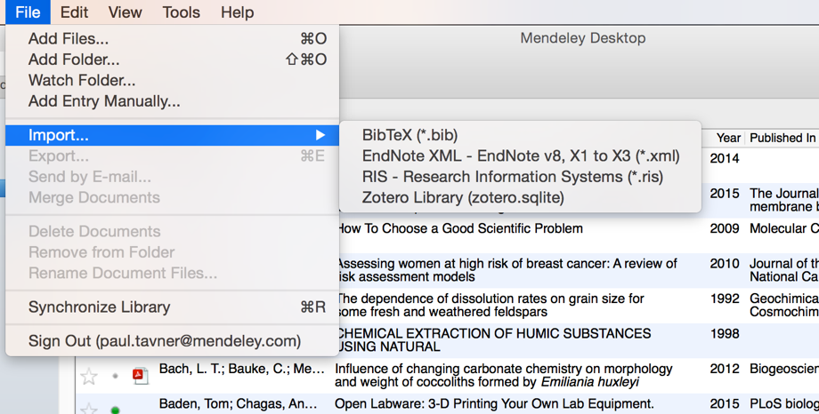
Adding Documents
Select a file or folder to
add from your computer
Import from another reference
manager, or BibTeX
Watch a folder
Add reference by
manually entering details
Notes:
Mendeley also offers a number of other options for adding material to your library. You can find these by opening the File menu.
You can choose to add individual files, or the contents of an entire folder by browsing to the relevant location on your computer.
You can opt to ‘watch’ a folder - which will mean that Mendeley monitors that location for any new items being dropped into the folder. If it finds a new document, that document will be automatically added to your Mendeley library.
You can also easily import a library from other reference managers, so if you’ve tried out EndNote, Reworks or another solution and found them not to your liking, you can carry across your library to Mendeley easily.
You also have the option to create a reference manually - which will allow you to complete a number of fields by hand.

Slide 12
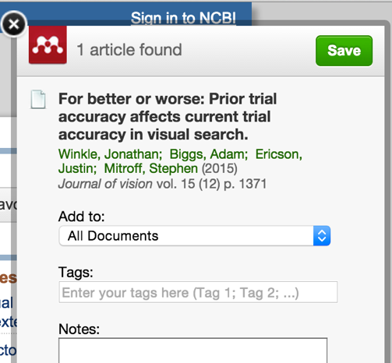
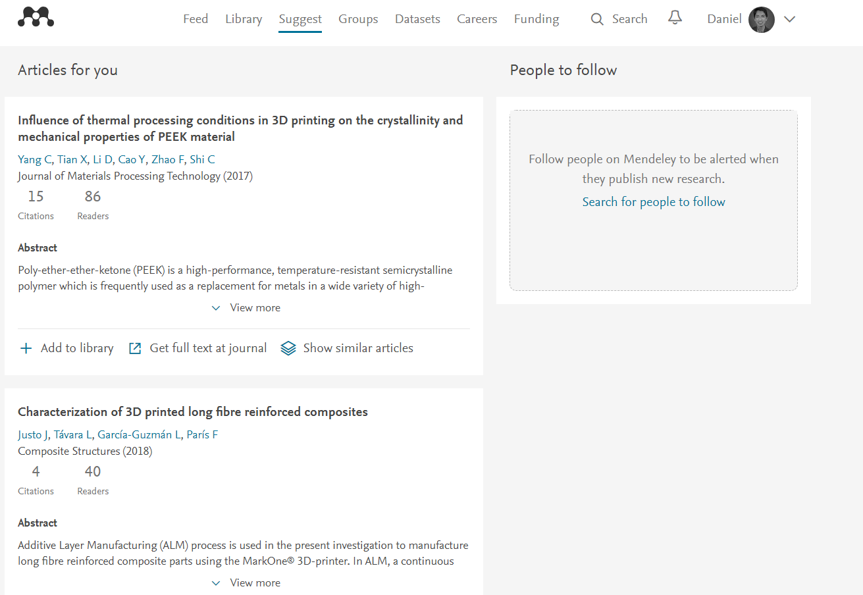
Finding New Research
Mendeley Web Importer
Mendeley Suggest
Notes:
Mendeley makes it easy for you to continue building your library.
The Web Importer is a bookmarklet that you can add to your web browser. When you click on this item in your browser’s favorites, the Web Importer will attempt to detect references on the page you’re viewing and ask if you want to add them to your library. You can also use it to add web pages to your library. I’ll show you the Web Importer in more detail shortly.
Mendeley also operates a Research Catalog - the largest crowd-sourced collections of Papers available online. You can search the online catalog to identify references you want in your library, and add them with just a few clicks.
Certain online catalogs, such as ScienceDirect - pictured here - allow you to export references directly to Mendeley. Look out for the Export button on pages like this.
Other catalogs will allow you to export in file formats such as RIS, which can then be added to Mendeley using the File menu.

Slide 13
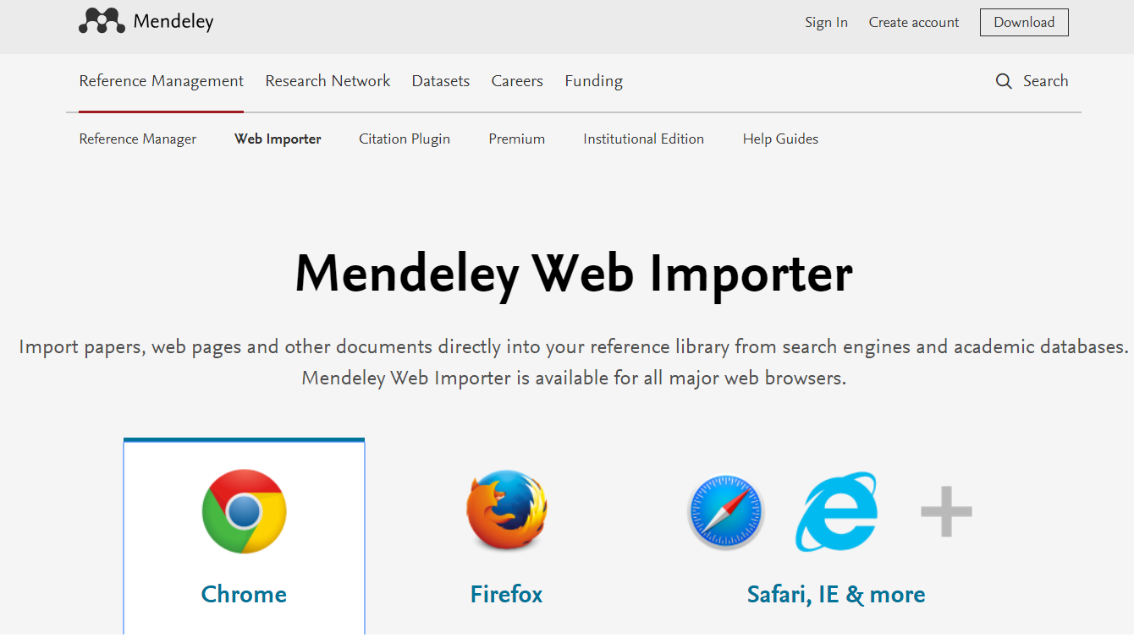
Mendeley Web Importer
Notes:
Mendeley makes it easy for you to continue building your library.
The Web Importer is a bookmarklet that you can add to your web browser. When you click on this item in your browser’s favorites, the Web Importer will attempt to detect references on the page you’re viewing and ask if you want to add them to your library. You can also use it to add web pages to your library. I’ll show you the Web Importer in more detail shortly.
Mendeley also operates a Research Catalog - the largest crowd-sourced collections of Papers available online. You can search the online catalog to identify references you want in your library, and add them with just a few clicks.
Certain online catalogs, such as ScienceDirect - pictured here - allow you to export references directly to Mendeley. Look out for the Export button on pages like this.
Other catalogs will allow you to export in file formats such as RIS, which can then be added to Mendeley using the File menu.

Slide 14
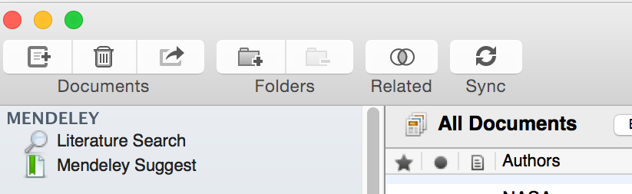




Sync
Notes:
Syncing is a core concept in Mendeley. Whenever you make changes in Mendeley, you’ll need to sync in order to push those changes up into cloud storage. Syncing will also pull down any changes made on other devices. It’s a good idea to sync regularly to ensure that your documents and annotations are saved in the cloud.
You can sync at any time by using the sync button. Mendeley will also sync automatically each time you open it.

Slide 15
Organize:
Managing Your Library

Slide 16
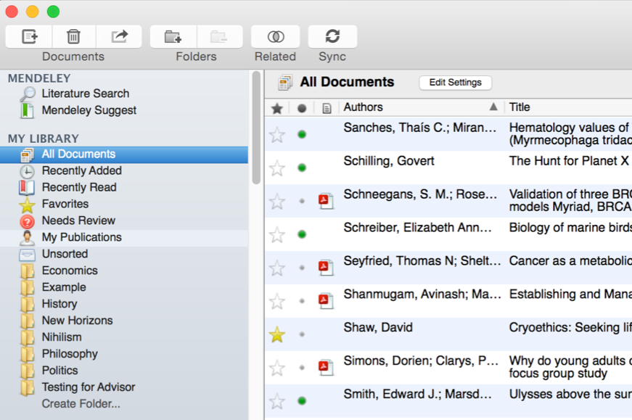





Manage Your Library
Use column
headings
to order your
references
All items in
your personal
library
Items added
in the last two
weeks
Mark entries
read or unread
Access your
recently read
items
Entries with
attached PDFs
can be opened
with the PDF
Reader
All items you’ve
starred in your
library
Items in need
of review
Star items to
mark them as
favorites
Notes:
Mendeley Desktop’s interface should be fairly intuitive if you’re familiar with programs like iTunes, or even Gmail. The left-hand panel offers a number of different options to help filter your document list to exactly what you need to find.
The default position when opening Mendeley Desktop is ‘All Documents,’ which will list all items in your library. You can use the column headings (such as Author Names, Year, etc.) to order your documents by that value - this can be useful for finding works by a specific author, for example.
When you add materials to your library, they will initially be marked as unread - indicated by a large green dot in the second column. You can toggle this off and on by clicking it. Alternatively, a document will be marked as read once you’ve spent a certain amount of time reading it in the Mendeley PDF reader.
You can ‘star’ documents to mark them as favorites. They can then be easily retrieved via the left-hand panel.
You can also use the left-hand panel to access items you’ve recently added, or items you’ve recently read.

Slide 17
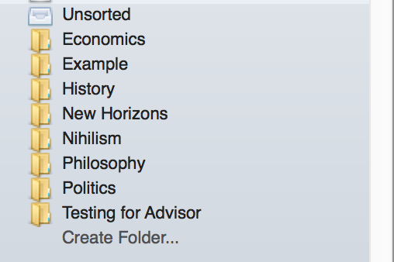
Create and Use Folders
References not added to a folder
will appear in ‘unsorted’
Your folders will be listed below.
Drag and drop to re-order them.
Use ‘Create Folder’ to enter a
new folder name.
Notes:
Folders allow you to quickly file your references under different topic headings. You can drag and drop references from your library onto the folder name in the left panel to add that reference to a folder.
You can also create folders within existing folders.

Slide 18
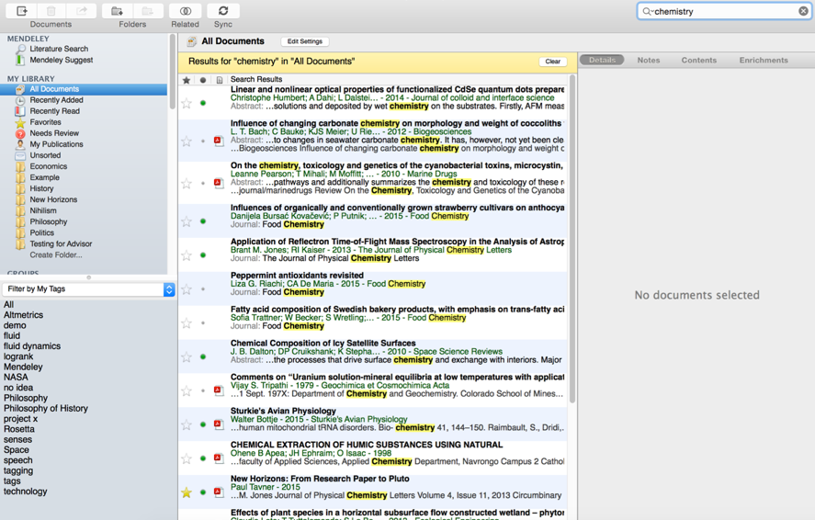
Search Your Documents
Enter your search term
in the search field
The main view will be
filtered accordingly
Click on a specific folder
to search within it
Use the clear button to
remove the search filter
Mendeley’s search tool
will look at reference
metadata, but will also
search within the full text
of PDF papers.
Notes:
Mendeley offers a powerful search tool to help you to locate items in your library. Just enter your search term in the field which appears in the top right corner and Mendeley will filter your current view to show references which contain that term. It will also search within the full text of PDF papers which appear in your library.
The search is context specific, so if you’re not getting the results you expect make sure that you have the appropriate folder selected in the left-hand panel. If in doubt, select ‘All Documents’.
Use the ‘clear’ button which appears on the yellow toolbar to remove the search filter.

Slide 19
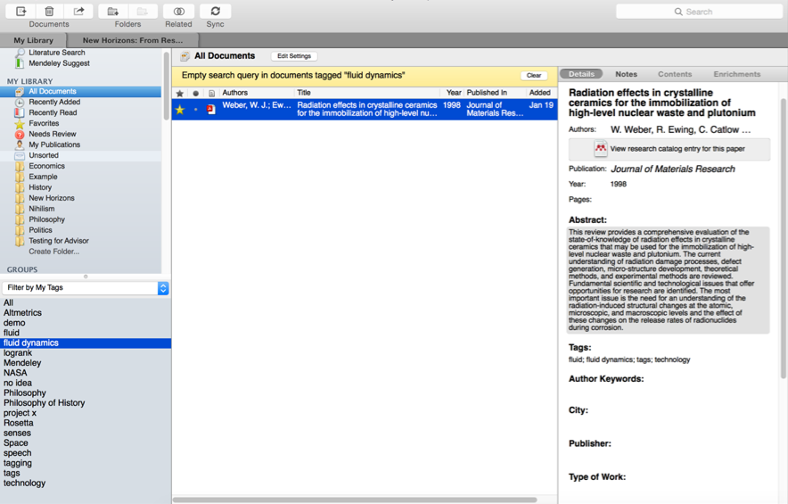
Search Your Documents
Add tags to papers in your
library which share a common
theme
Use the Filter Menu to filter
your library view to only include
tagged items
You can also filter by Author,
Author Keywords and
Publication
Notes:
You can also use tags to help locate a reference or references within your library. You can add multiple tags to your references using the document detail panel when you have the reference selected.
Then use the Filter by My Tags menu which appears in the bottom left corner to quickly pull up materials that you’ve tagged.
The list of available tags will only display tags used in your current folder view - so, again, make sure you are viewing the appropriate folder or All Documents before attempting to filter.

Slide 20
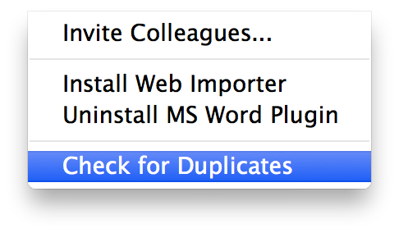
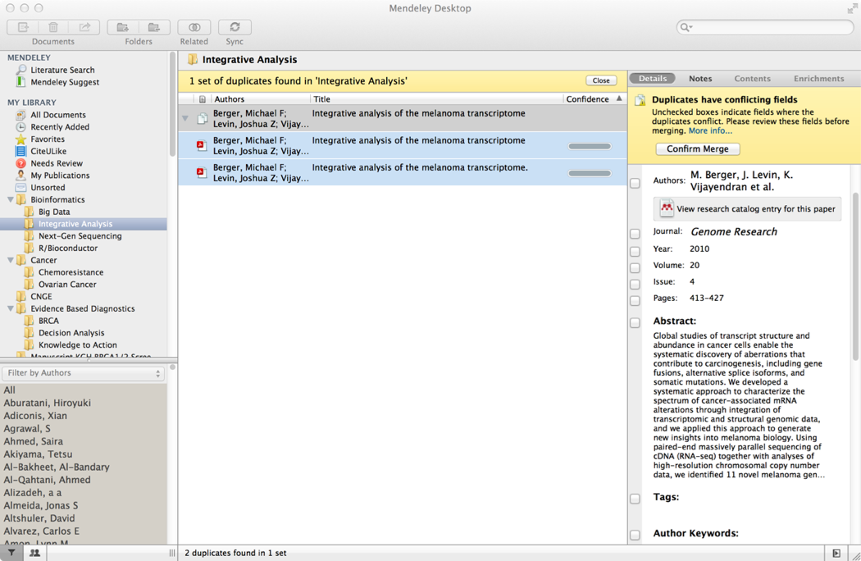
Checking for Duplicates
Notes:
You may find that after collecting a library of references that you have accumulated some duplicate entries - where two copies of the same reference have been added to your library.
Luckily, Mendeley can clean these up for you. Use ‘Check for Duplicates’ - found in the Tools menu. Mendeley will identify any duplicate entries and offer to merge these into a single, combined entry. You will be prompted to check over the details of the combined version before the merger is completed - allowing you to take details from each of the entries you’re merging.

Slide 21
PDF Viewer
Highlight and Annotate Documents

Slide 22
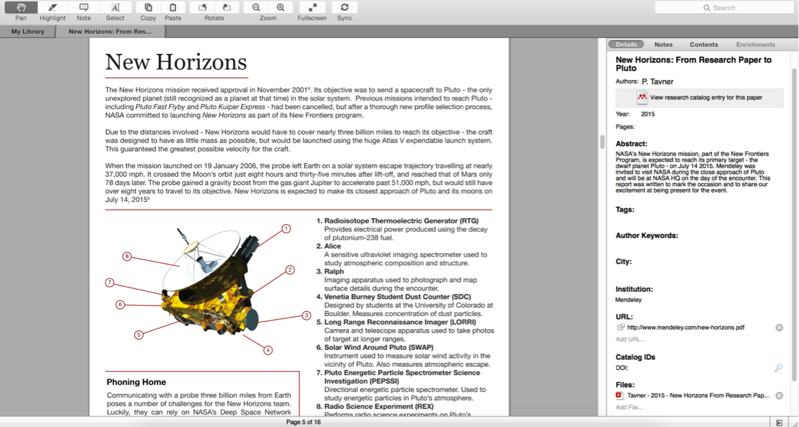
The PDF Viewer
Notes:
The Reader’s layout will be familiar if you’ve used Adobe Acrobat or similar software. At the top of the screen you’ll see a number of tools, which are mostly self-explanatory.
You’ll also notice that Mendeley operates a tabbed format - allowing you to open multiple PDFs for reading at once, and to switch back and forth between them.
Mendeley will remember where you were up to in a paper when you open it and take you back to the same place.

Slide 23
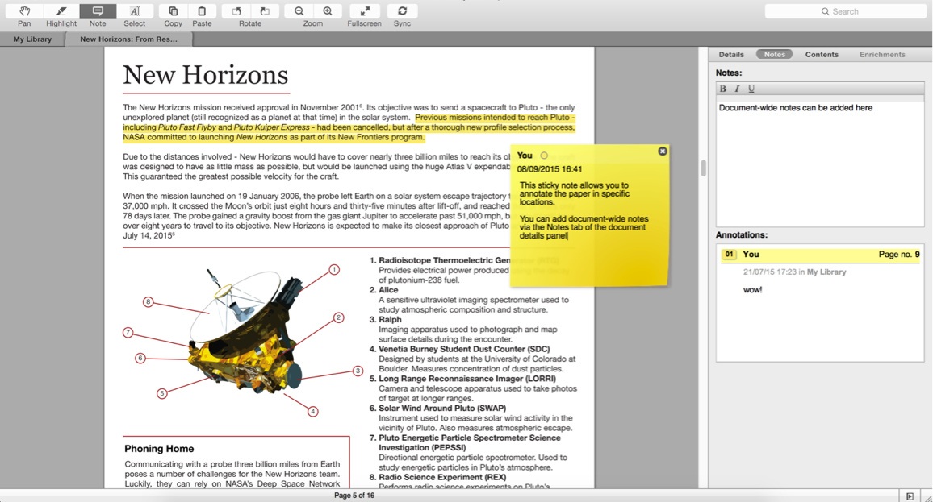
Highlighting and Annotating
Notes:
You can highlight important passages using the Highlight tool - just as you would when reading a physical copy. This allows you to pick out important passages from a paper.
You can also add notes to the paper to help organize your thoughts. These can be done either in the Notes box which appears in the document detail panels. These notes are document-wide and can also be viewed from the main library view - without opening the paper for reading.
Alternatively, you can add ‘sticky notes’ to specific locations in the text. These allow you to make content-specific notes at a particular location. Sticky notes that are added in this way will appear in the list of annotations in the document details panel. You can use these entries to jump to the appropriate location within the paper - allowing you to retrieve your notes in context.

Slide 24
Cite:
Using the Mendeley Citation Plug-In
Notes:
One of the most popular features of Mendeley is its ability to improve the citing process. Mendeley makes it a lot easier to insert properly formatted citations throughout a paper you’re writing - and will automatically generate a bibliography for you. It also allows you to restyle your manuscript’s citations with just a few clicks - making it ideal for resubmissions to different journals or publishers.

Slide 25
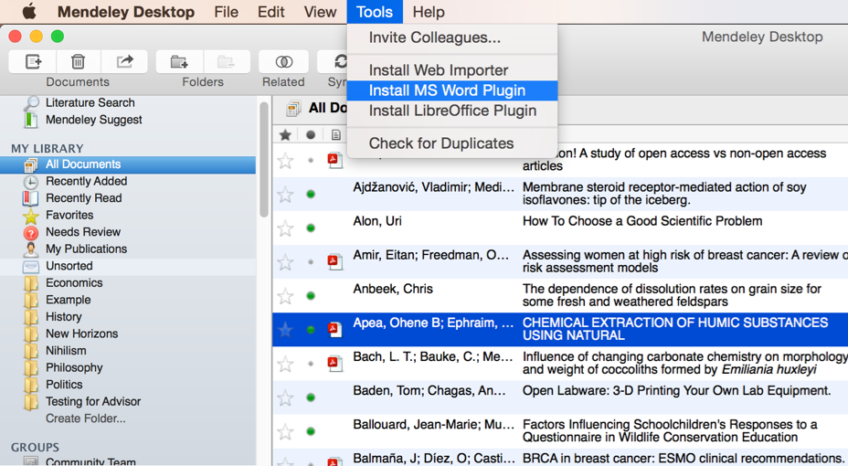


Install the Citation Plug-in

Slide 26
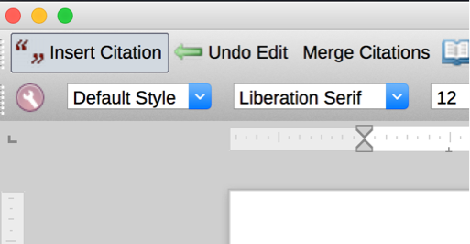
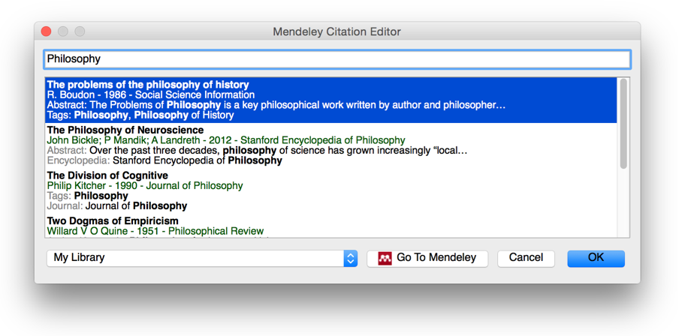

Generate In-Text Citations in Word
Notes:
Inserting a citation is achieved by first positioning your cursor in the appropriate location and pressing the ‘Insert Citation’ button which appears on the Mendeley toolbar. You also need to be running Mendeley Desktop, and will be prompted to start it if it is not currently running.
Pressing the button will open the Mendeley search tool. This box allows you to enter a term - such as an author name - before returning search results from your library. Locate the reference you want to cite, click to select it and press the Ok button. You will see that the citation is added. Its appearance will vary depending on which citation style you currently have active - we’ll talk more about this shortly.
That’s all there is to it - you’ve added your first citation! Congratulations!
If you’re looking for a particular citation and can’t remember its details you can also opt to switch to Mendeley desktop to locate it - using search or filtering by tags, for example. Just press the ‘Go to Mendeley’ button to switch over to that interface.
Once you’ve located the appropriate reference, click to highlight it and press the ‘Cite’ button which temporarily appears on the Mendeley Desktop toolbar. If you want to cancel the citing process and return to your manuscript press the cancel button.
Note that your manuscript is considered locked while this process is active. You need to cancel the citation to return to the document, or insert a citation before you can switch back to your word processor.

Slide 27
Merging Citations
Notes:
Many publishers require adjacent citations to be combined into a single, properly-styled format. Mendeley can handle this for you. Just insert two separate citations, highlight them both in the word processor and press ‘Merge Citations’ to combine them.

Slide 28
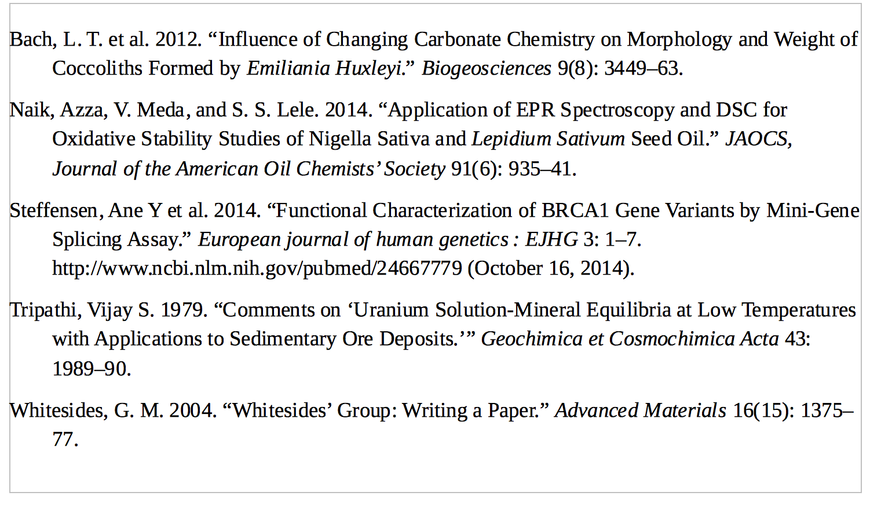
Inserting Your Bibliography
Notes:
Once you’ve done adding citations you’ll need to generate a bibliography. Ensure your cursor is positioned where you want your bibliography to appear and press the ‘Insert Bibliography’ button - it just takes one click!
Mendeley will now look through your manuscript, pick out all the citations you’ve added and order them into a list. The exact ordering and appearance of your bibliography will depend on the citation style - which we’ll talk about next.

Slide 29
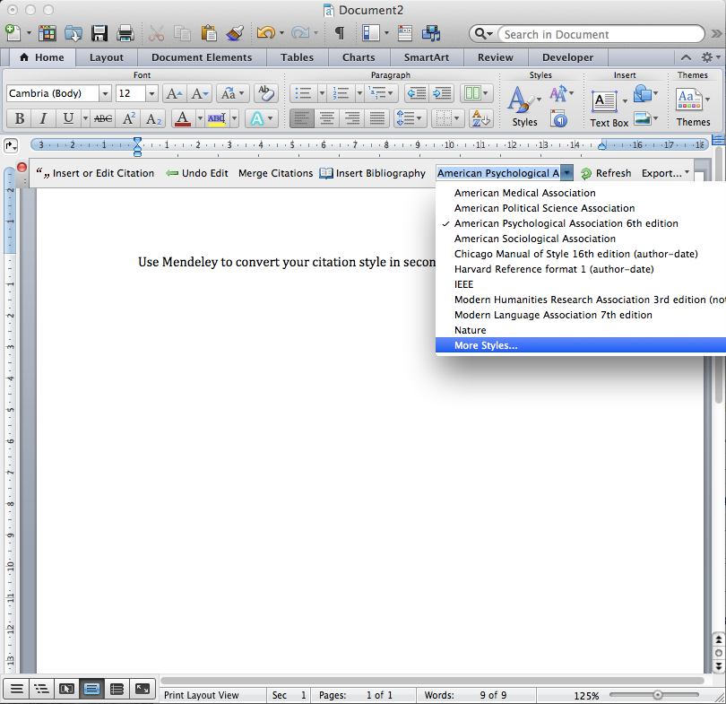
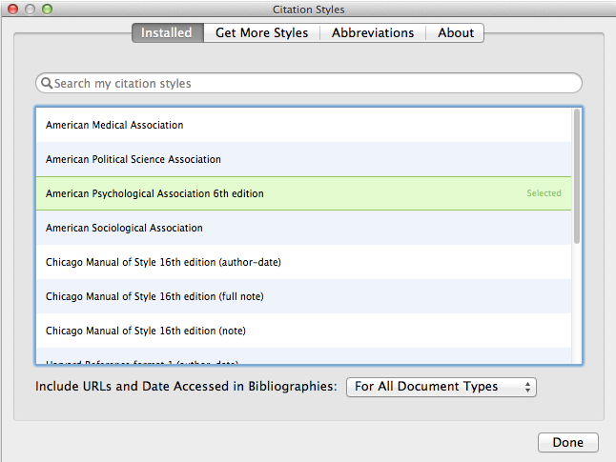
Finding a Citation Style
Can’t find the right style? No problem, Mendeley has a
style editor which can be found at http://csl.mendeley.com
Notes:
Citation Styles are sets of styling instructions which control how your citations and bibliography appear. Different publishers and institutions require different formatting for citations when you wish to submit a paper.
Using Mendeley, you can choose the appropriate citation style for your manuscript - and also switch between different styles with just a few clicks. Mendeley will restyle all the citations in your manuscript automatically. To change citation styles, open the styles dropdown menu which appears on the Mendeley toolbar. If you don’t see the style you need, you can click ‘More Styles’ to be taken to the Styles tool within Mendeley Desktop. This will also allow you to download and install new styles in seconds.
Mendeley allows you to use over 1,600 different citation styles - but comes pre-installed with some of the most commonly used, such as APA, Harvard and IEEE.
If you still can’t find the right style or you’d like to customize an existing style, you may want to try the Mendeley CSL Editor, which allows you to customize citation styles. Saved styles are added to the Mendeley database, and will appear in your drop-down menu in Word.
You can also share created styles with other Mendeley users. The editor can be found at http://csl.mendeley.com

Slide 30
Collaborate
Join and Create Groups to Share References

Slide 31
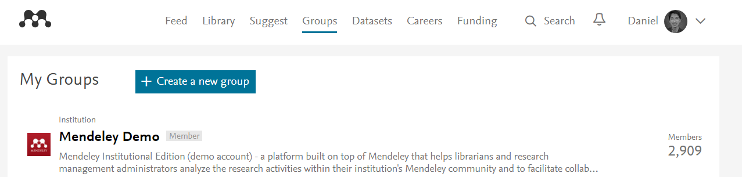
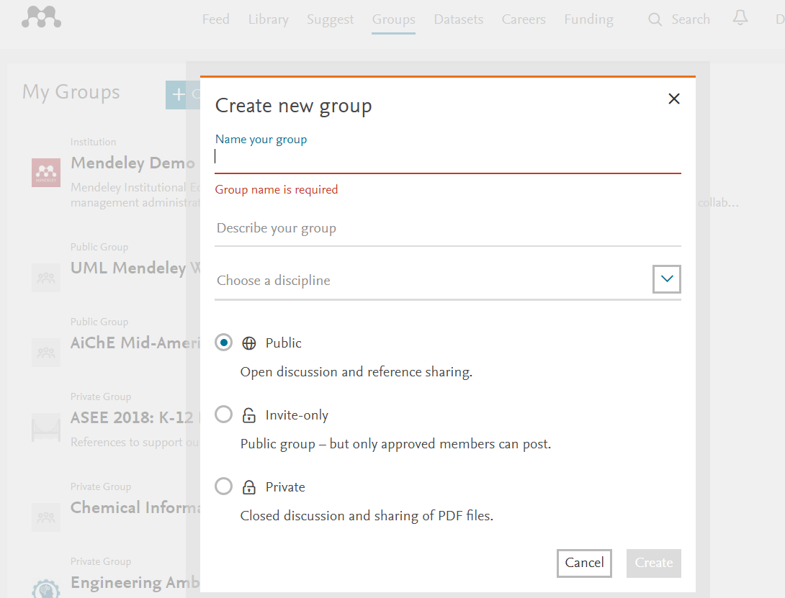
Mendeley Groups
See the groups you created, joined or follow.
Add documents to a group by dragging and dropping.
Notes:
Groups are Mendeley’s solution to the the problem of collaboration. They allow you to come together with other users and to share resources. If you’ve already created or joined groups, you’ll see them listed in the left panel of Mendeley Desktop - underneath your personal folders. To add materials to a group, just drag and drop them onto the group name.
You can create new groups at any time by using the ‘Create Group…’ option. The process is quick and easy. Mendeley offers three different types of group:
Open - these groups are publicly visible and accessible to anyone. They will be listed in the groups directory on Mendeley’s website. Members can add references to the group - but only the reference details will be added.
Invite-only - these groups are publicly visible, but membership is controlled by the group admins. Anyone can ‘follow’ the group to access the references, but only full members can add or edit references.
Private - these groups are not publicly visible. Members need to be invited. Members can share full-text papers with each other, and can also collaboratively highlight & annotate on these materials.

Slide 32
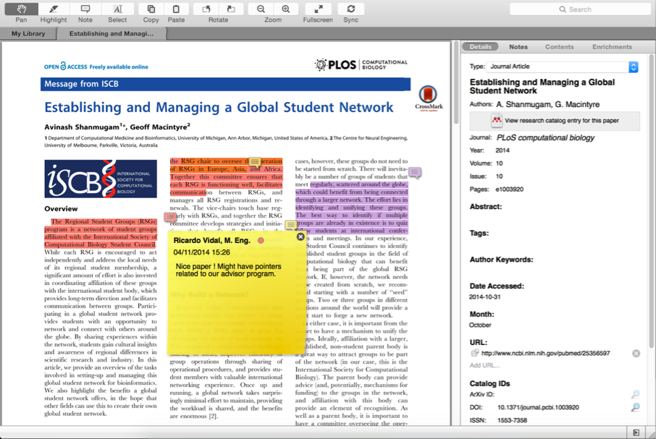
Private Groups
Collaborate with Your Research Team
Share full-text
documents with members of your private group
Share highlights and annotations
Each group member is assigned a different color for highlighting
Notes:
Private groups, like all groups, offer the ability to communicate with other members via messages posted to the newsfeed. You’ll also receive notifications when new resources are added.
Each post on the group’s newsfeed creates a discussion thread - allowing you to comment on other members’ posts.
You can open papers shared with the private group using the Mendeley PDF Reader. Any highlights and annotations you add to the group version will be visible to other members of the group. Each contributor will be assigned a color to help distinguish their changes.
Add notes or highlight particular passages to draw your collaborators’ attention to particular sections of the paper.

Slide 33
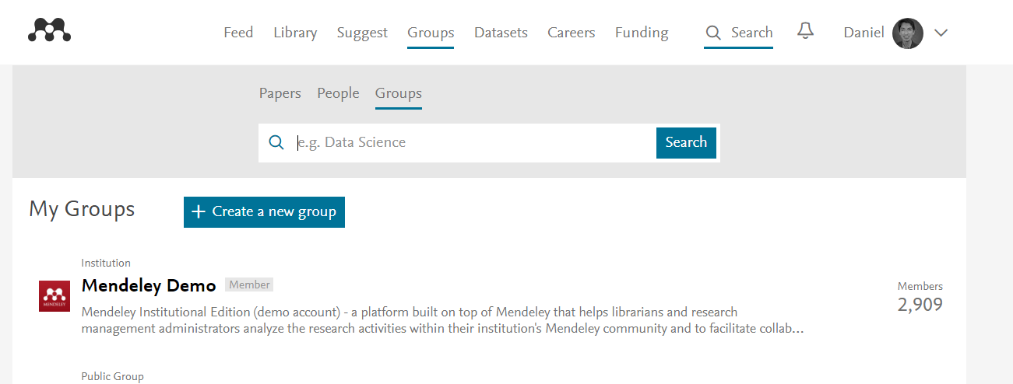
Browse & Join Public Groups
Notes:
You can also browse popular public groups by subject to locate popular groups associated with each topic.
Joining public groups is also a good way to connect with other Mendeley users who are active in your field. This can lead to collaboration and sharing of resources.

Slide 34
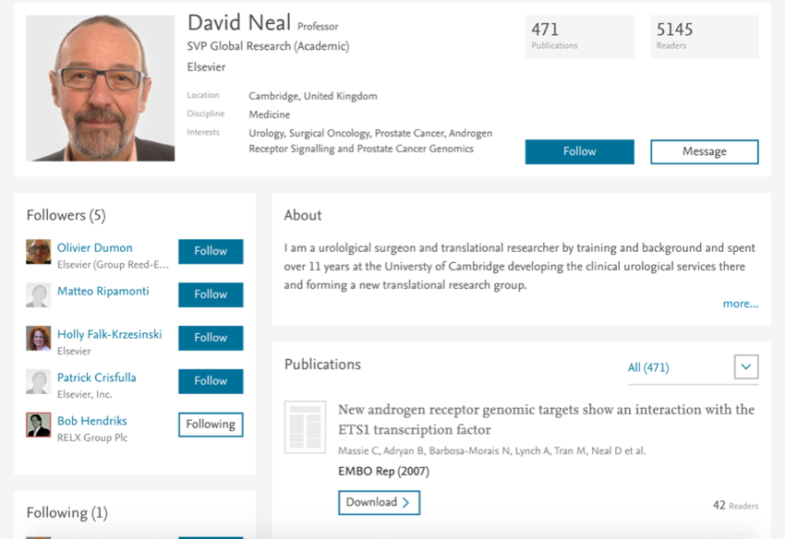
Create Your Research Profile
Receive personal stats on how your work is used
Promote your work and interests to a global audience
Connect with colleagues
and join new communities
Share your work with other researchers
Notes:
Completing your Mendeley profile is a great way to promote yourself and to encourage other users to get in touch. You can use your profile to share your interests and publications with the world.
When viewing another user’s profile you will have the option to ‘follow’ them, which will keep you up to date with their activity. You can also send them a direct message.

Slide 35
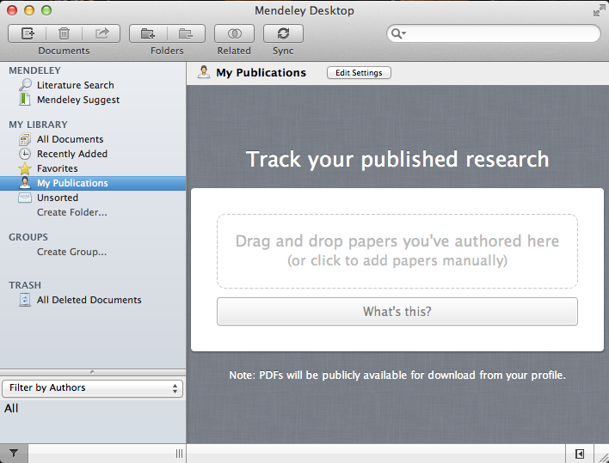

Showcase Your Publications
Add your own publications
Mendeley adds the PDFs to the public database
Showcase them on your profile
Notes:
You can use Mendeley to share your work with other users by adding your publications to your personal profile. Adding publications will make them available to other users via your profile, as well as connecting you to them in the Mendeley Web Catalog. If other users view your paper in the Catalog, they will see that you are a Mendeley user and will be able to connect with you.
To add your personal publications, open ‘My publications’ in Mendeley Desktop, and either drag & drop a file onto the specified area, or click to browse to a file on your computer.

Slide 36
Discover
New Research, Recommendations, and Impact
Notes:
In addition to groups and individuals, Mendeley also offers you the ability to discover new research. By drawing on the crowd-sourced catalog of materials, Mendeley can draw on one of the largest resource libraries available online - one that’s continually growing as users add more materials.

Slide 37
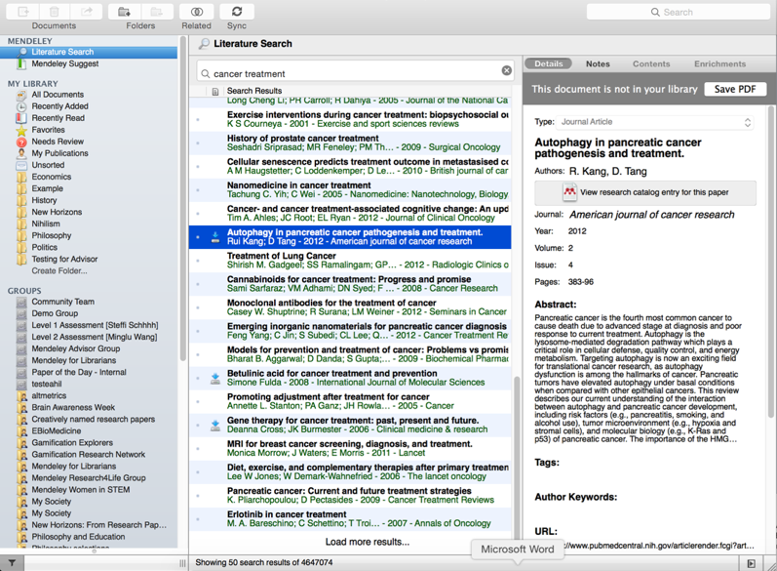
Literature Search – Mendeley Catalog
Search the
catalogue
Save new research to your library with one click
If the full text is available, you’ll see a download icon:
Notes:
If you know the name of a paper or if you have a specific topic in mind, you can use the Literature Search setting from within Mendeley Desktop. This allows you to retrieve new references from the Mendeley Web Catalog.
As the Catalog is crowd-sourced, the Literature Search can only retrieve papers that have already been added by other users - so if your desired result is a very new or obscure paper, you may not be able to retrieve it.
If the full text of a paper is available - for example, if the paper is open access - you’ll see an icon allowing you to download it.

Slide 38
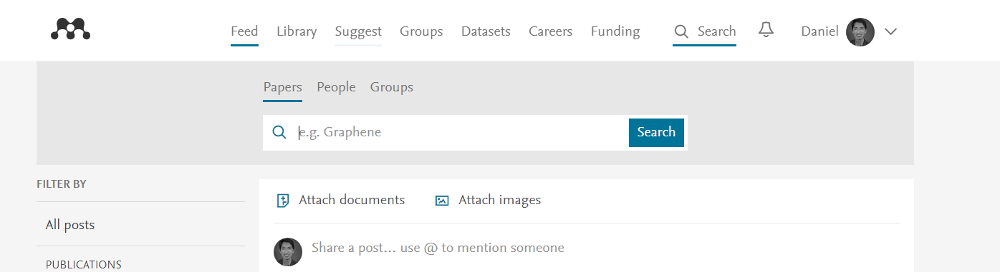
Search the Web Catalog Online
https://www.mendeley.com/guides/web/02-paper-search

Slide 39
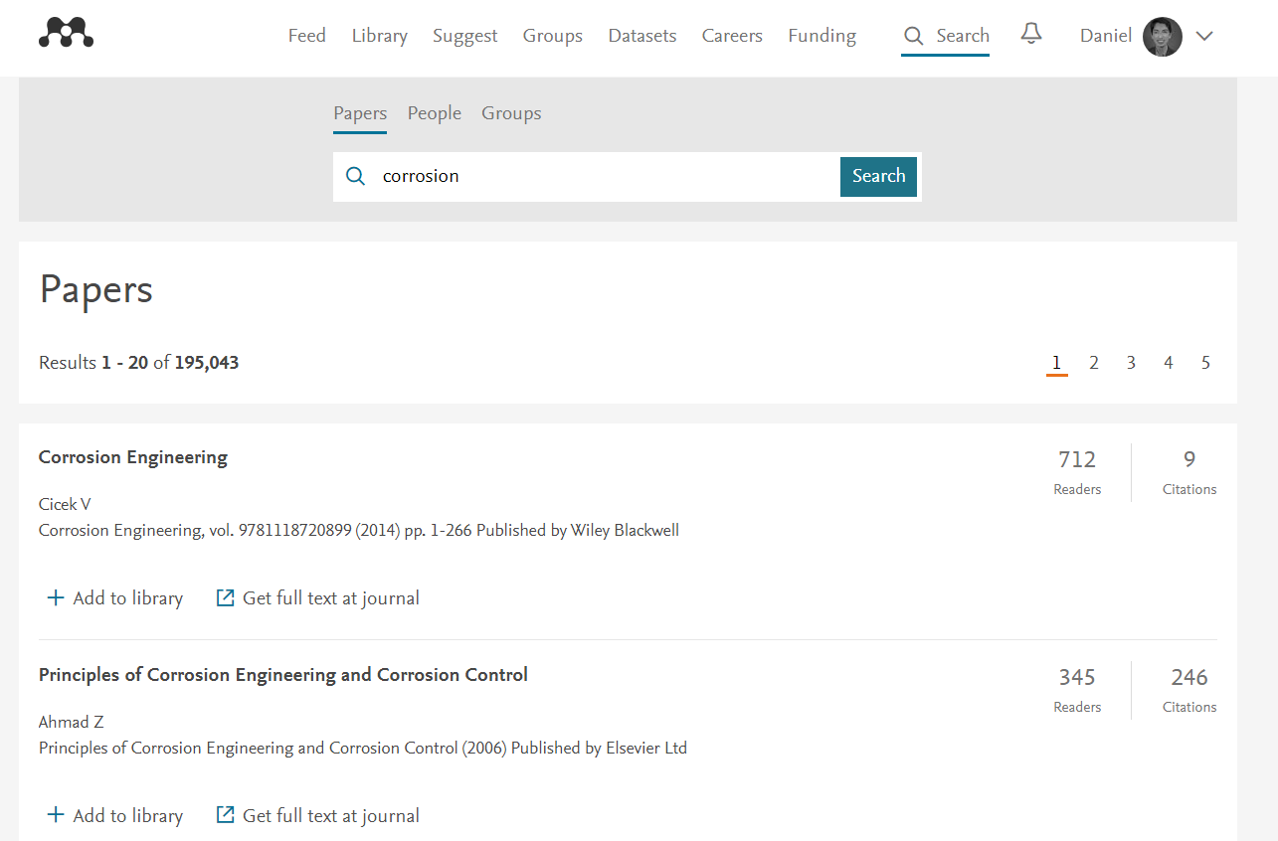
Quickly Add New Research
If the article is freely available, it’s a one-click addition to your library
Or use Open URL to locate the full text

Slide 40
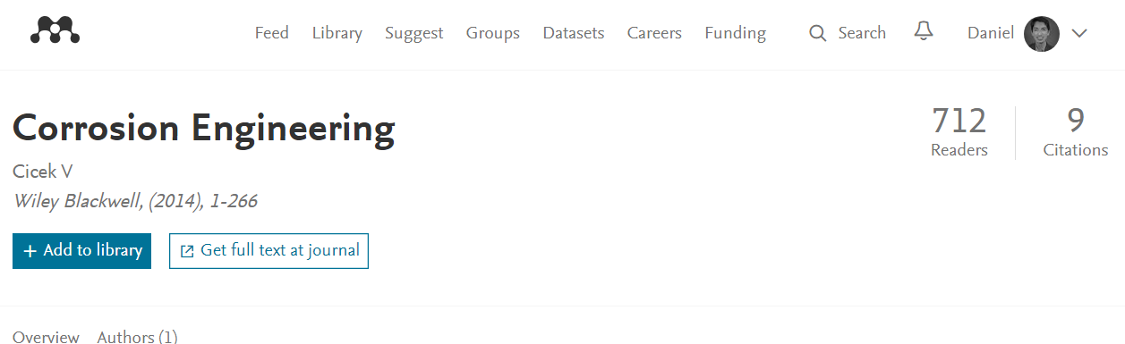
Get Statistics

Slide 41
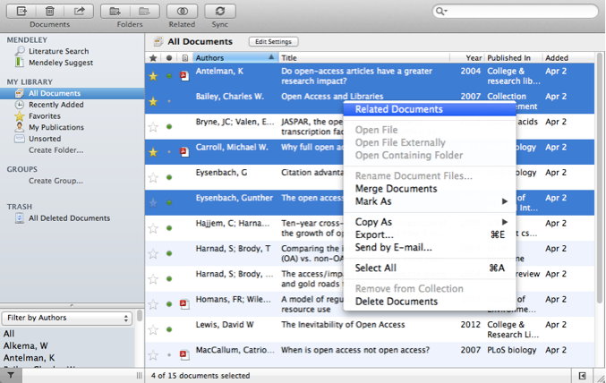
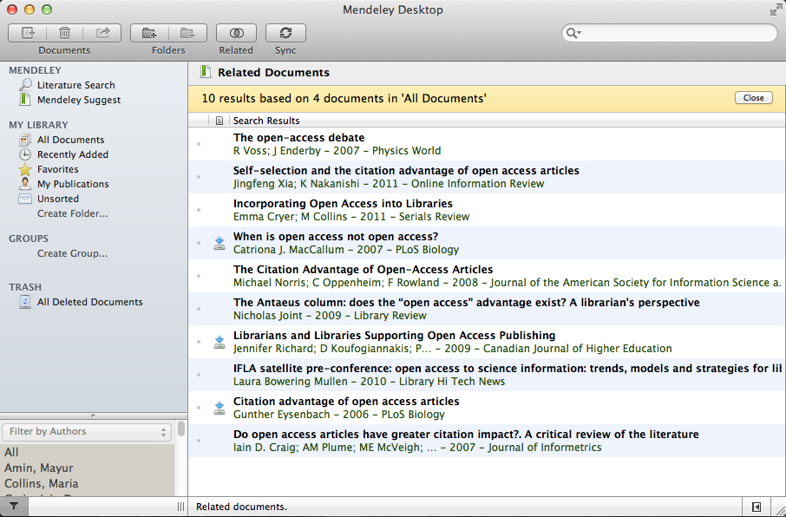
Related Documents
Select two or more articles
Click ‘Related Documents’
Receive customized recommendations
Notes:
When viewing a web catalog entry, you’ll see the option to add the reference to your library with just a single click. If the paper is freely available - ie open access - you’ll also be able to download the full paper.
For other references, you can use the ‘Find this paper at’ dropdown menu to view different options. Using Open URL will allow you to retrieve a paper through your institutional access, providing your institution has the appropriate subscription.

Slide 42
Discover
Your Next Career Opportunity

Slide 43

Mendeley Careers
https://www.mendeley.com/careers

Slide 44
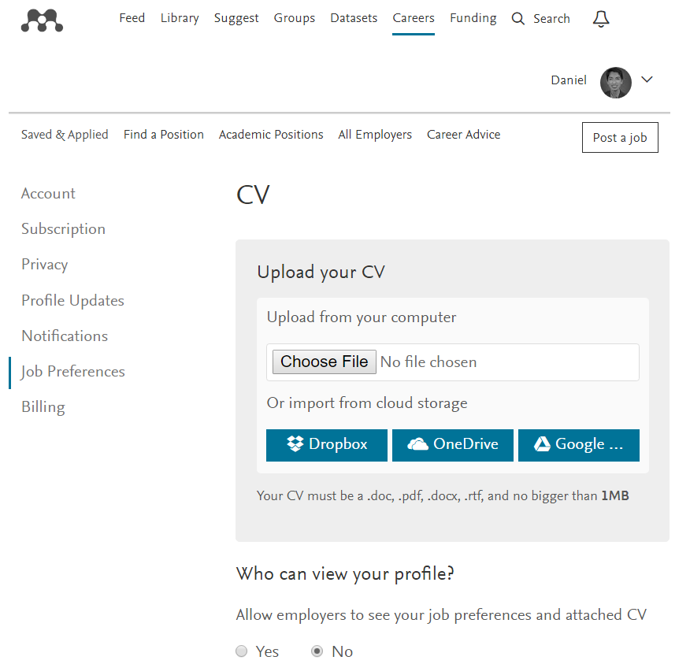
Upload Your CV

Slide 45
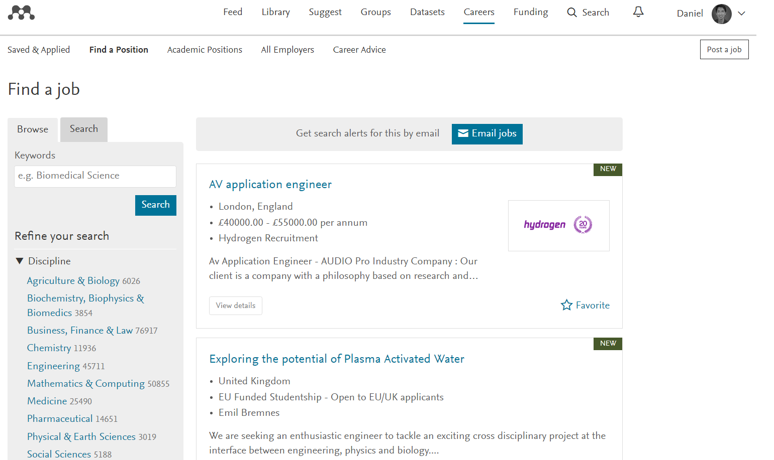
Find a Job

Slide 46
Discover Your Next Funding Opportunity

Slide 47

Discover Your Next Funding Opportunity
https://www.mendeley.com/research-funding/

Slide 48
Talk to Us
Let us know if you need help or resources
community@mendeley.com

Slide 49
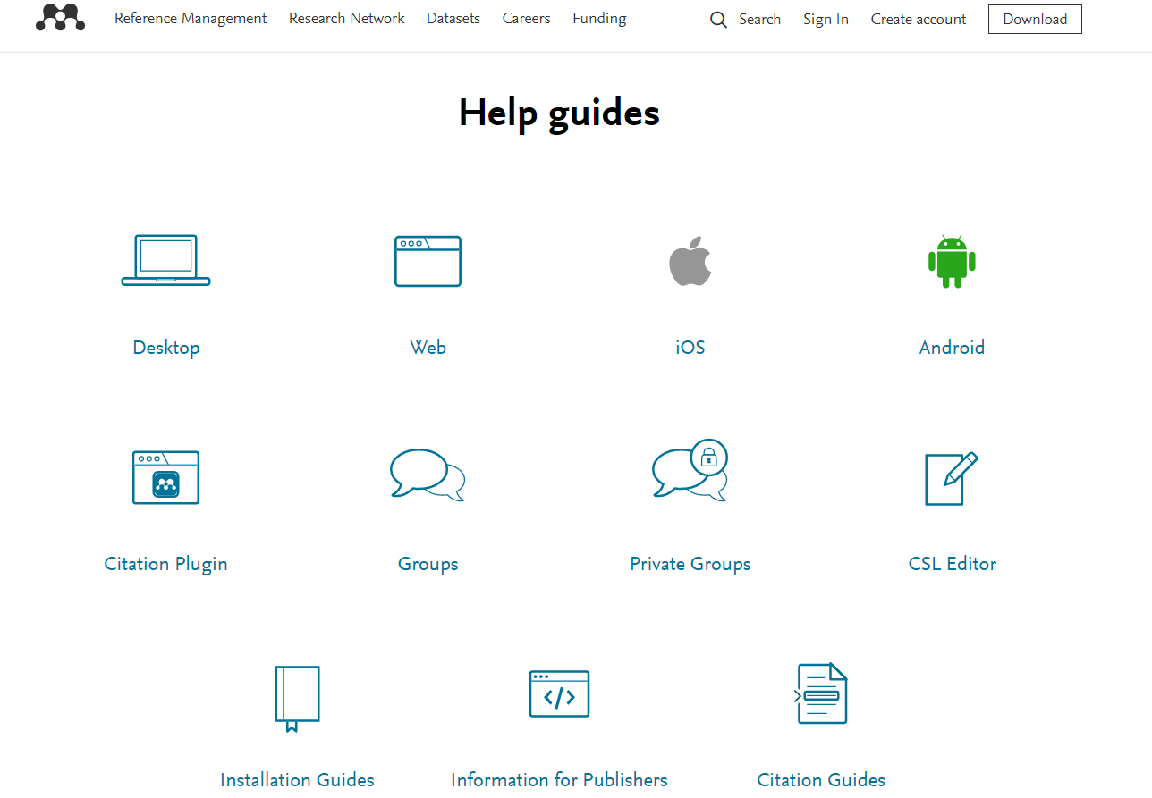
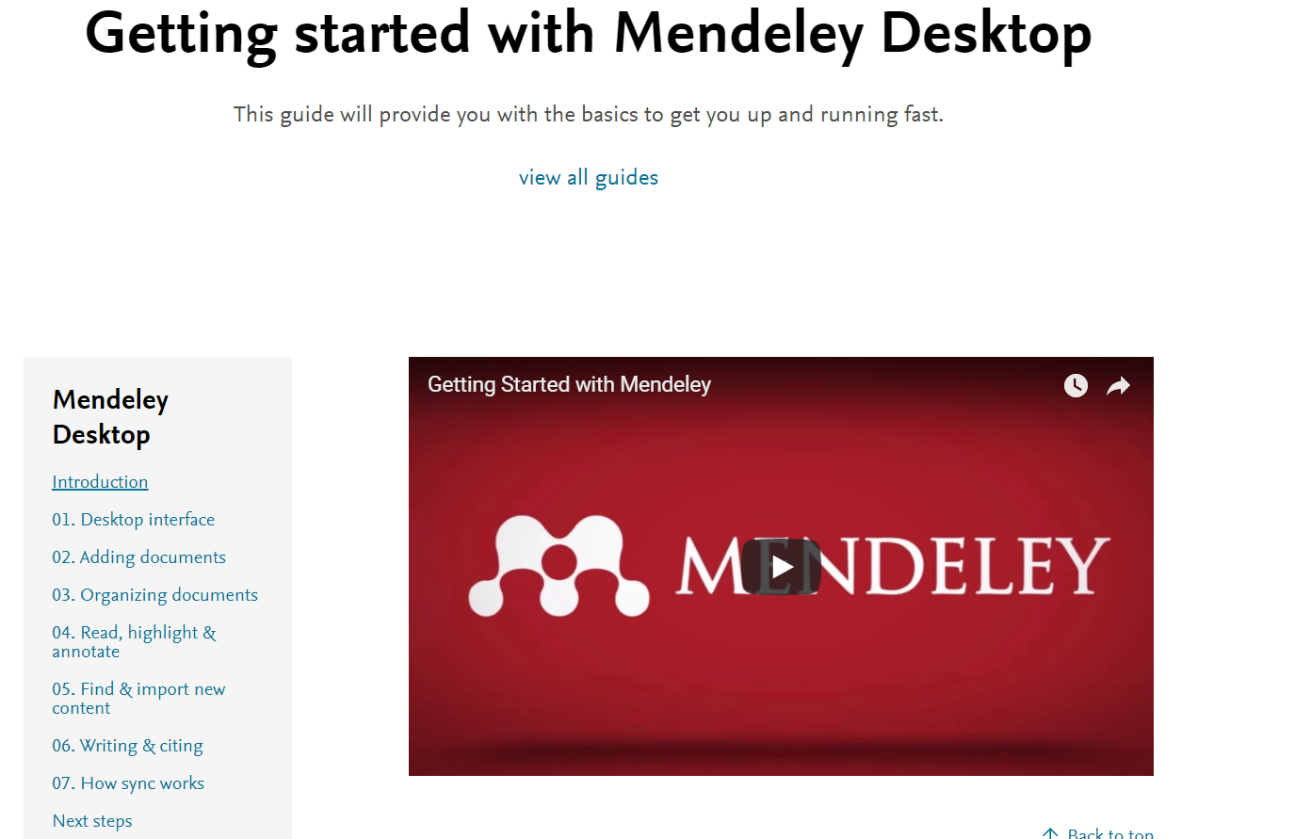
Mendeley Guides
https://www.mendeley.com/guides/

