Slide 1
The ISSN Network
Workshop meeting “Impact of the IFLA Library Reference Model on ISBD, RDA and Other Bibliographic Standards”
Wrocław University Library, August 25th, 2017
Clément Oury
ISSN International Centre
clement.oury@issn.org
@ISSN_IC
Notes:
15 minutes de speech, 5 minutes de questions

Slide 2
Impact of the IFLA LRM - the case of the ISSN Network - Clément Oury - Wrocław University Library, August 25th, 2017
The ISSN: a dedicated network for continuing resources
ISSN: standard and network created in 1975
An identifier for all kind of continuing resources
A decentralized assignment process
89 National Centres
Assignment associated to the production of a reference bibliographic record
A unique point of access to ISSN information: the ISSN Register
ISSN standard (ISO 3297) has entered a revision process
Coming soon: opening of new ISSN Portal to distribute ISSN information as linked data

Slide 3
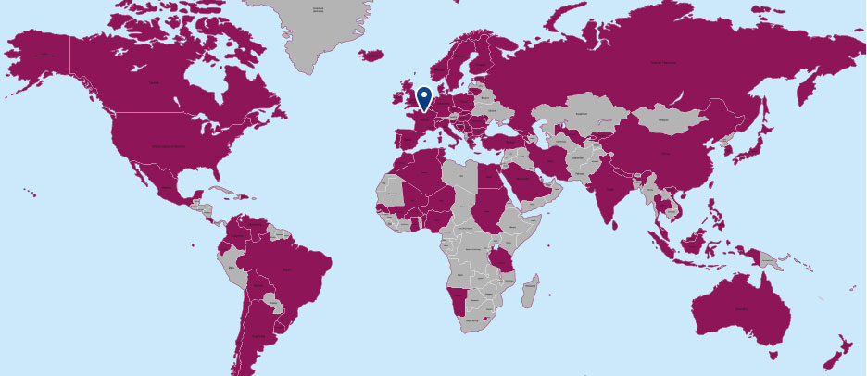
Impact of the IFLA LRM - the case of the ISSN Network - Clément Oury - Wrocław University Library, August 25th, 2017
The ISSN network today

Slide 4
Impact of the IFLA LRM - the case of the ISSN Network - Clément Oury - Wrocław University Library, August 25th, 2017
LRM, ISSN and Serials: main issues
Treatment of serials and other continuing resources in the LRM
No collocation for continuing resources?
Use of special models as PRESS_{OO}
LRM alignment of ISSN Manual
ISSN Manual based on the ISBD…
But it has its own authority system
LRM alignment of the ISSN identification system
What entity does an ISSN identify?

Slide 5
Food for though…
Notes:
15 minutes de speech, 5 minutes de questions

