Slide 1
RL Workflows – APC and Hybrid journals submissions and charges

Slide 2
General rules for all types of workflows
Authors should always use their affiliated email domains and the name of their affiliated institution to be recognized in RL.
The usage of non-affiliated email domains (e.g. commercial domains like @gmail.com, @yahoo.com) eliminates authors from the automatic recognition by RightsLink.
Omitting the affiliation name causes authors to be eliminated from the automatic recognition via the RINGGOLD number by RightsLink.
In effect, the metadata needs to be edited manually which slowed the funding distribution process.

Slide 3
Submission workflow for Pure oa journals

Slide 4
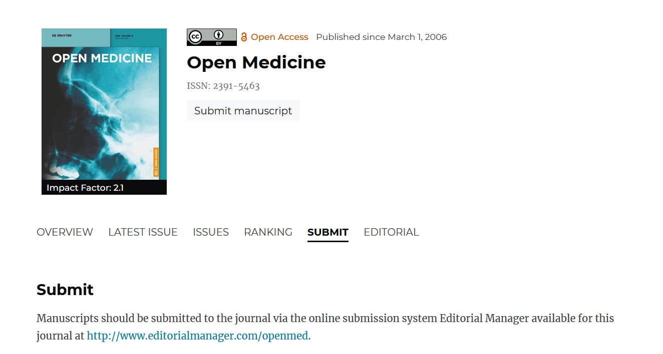
New submission
You can easily submit your manuscript online. Simply go to the journal webpage – you will be moved to the submission system page (Editorial Manager)

Slide 5
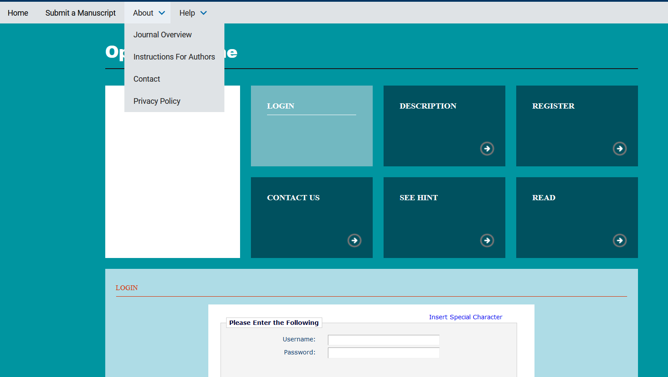
New submission
Please make sure that you read Instructions for Authors and Policies

Slide 6
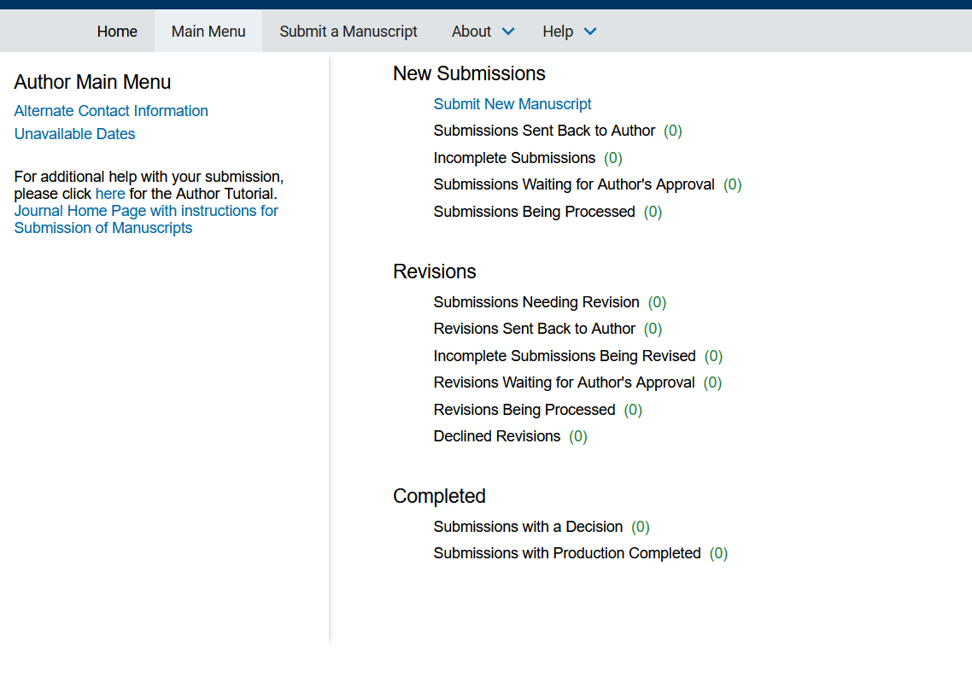
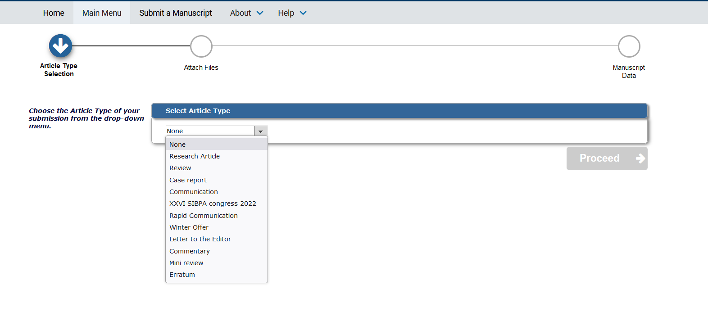
Basic information about the submission

Slide 7
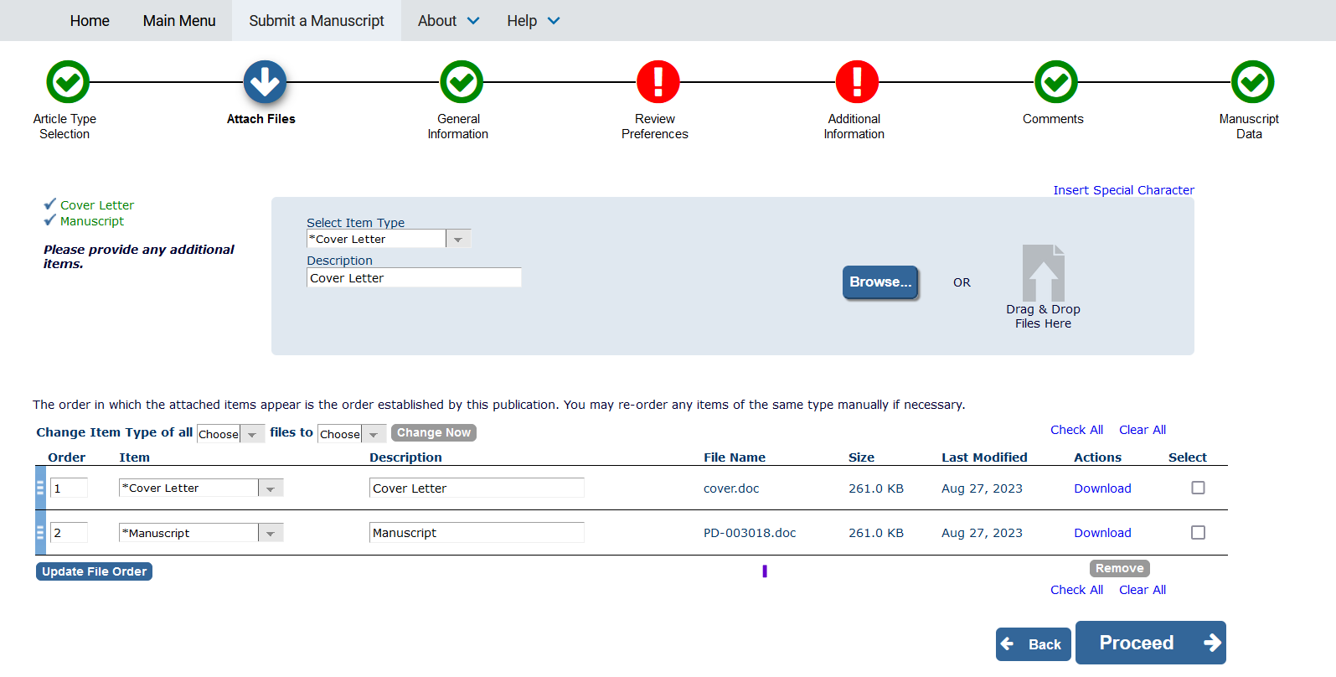
Manuscript upload
Apart from the manuscript, you might need to upload additional files

Slide 8
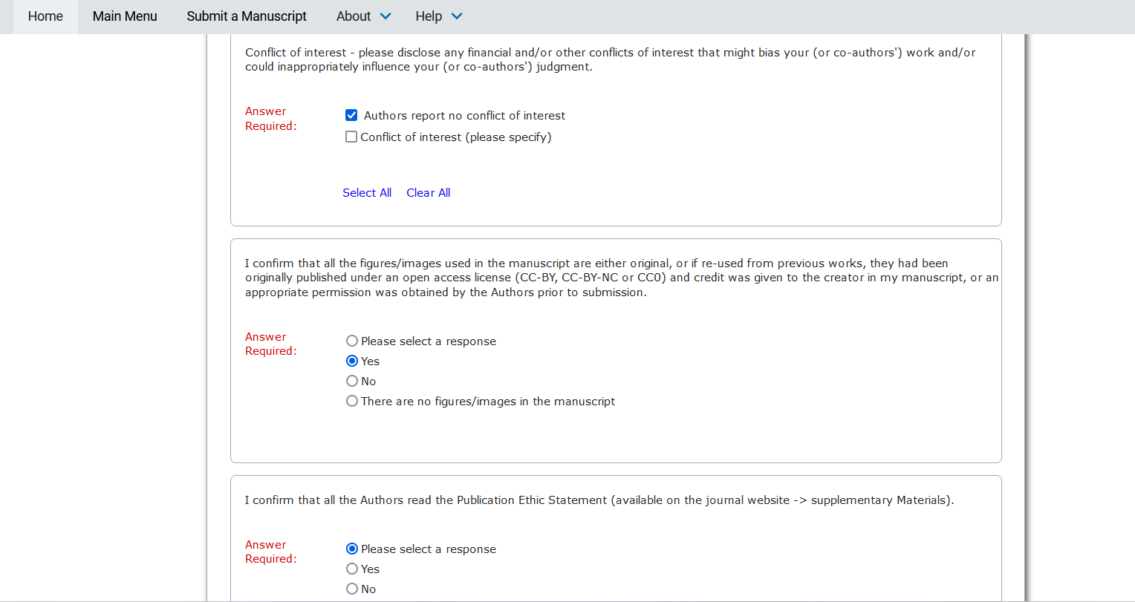
Additional information – policies
As well as you need to confirm information connected to publishing policies

Slide 9
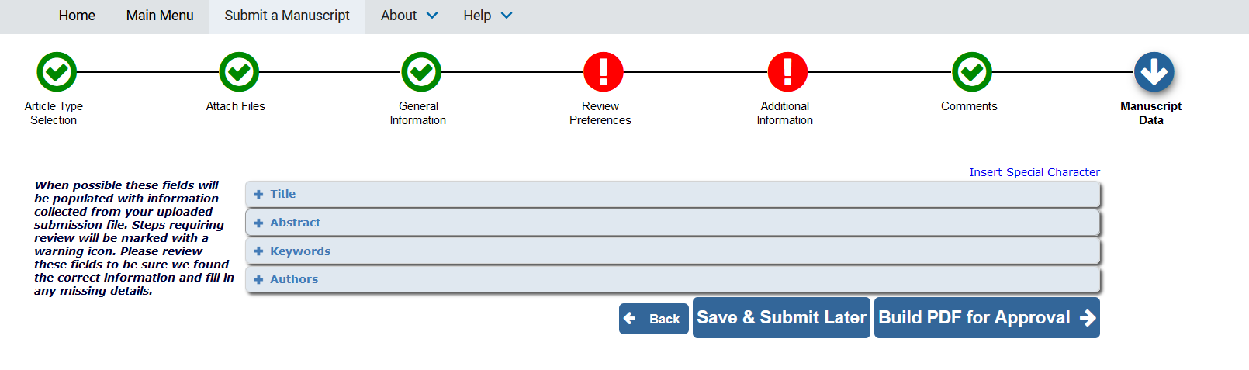
General information
Use your institution domain, it might be necessary for recognition of your funding eligibility
Add a minimum number of required keywords – that will be necessary for us to be able to provide you with a quality and relevant peer-review process

Slide 10
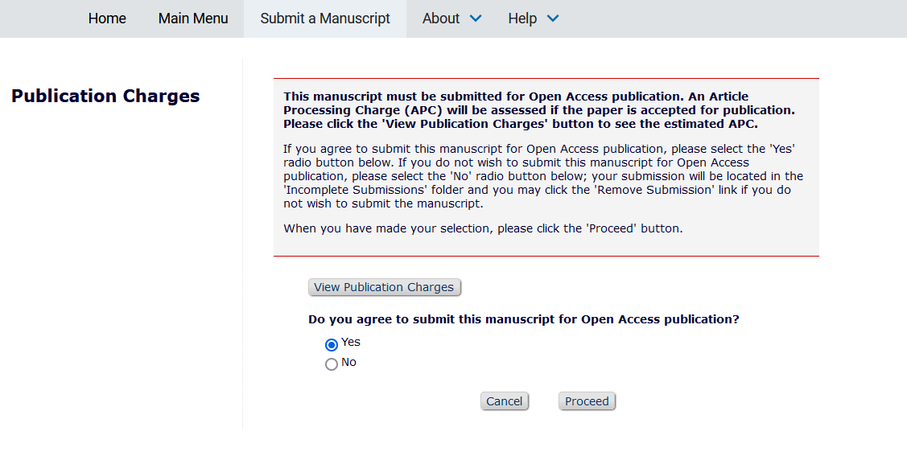
Article Publication Charges
Check relevant publication charges and confirm you agree for them

Slide 11
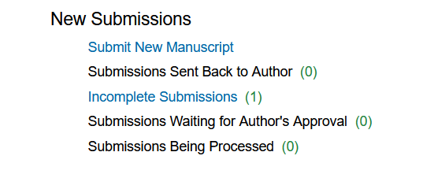
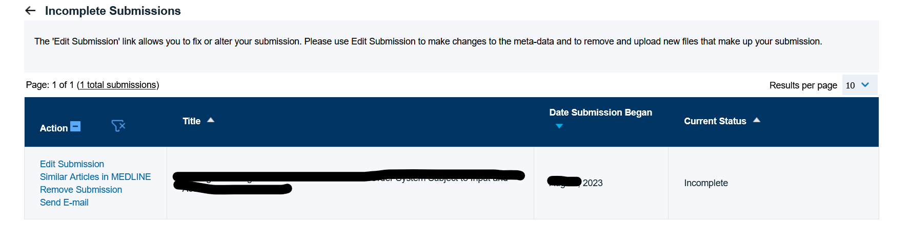
Author view
Here you will see your submissions, further in this main menu you will see the status of peer-review

Slide 12
Submission workflow for Hybrid oa journals

Slide 13
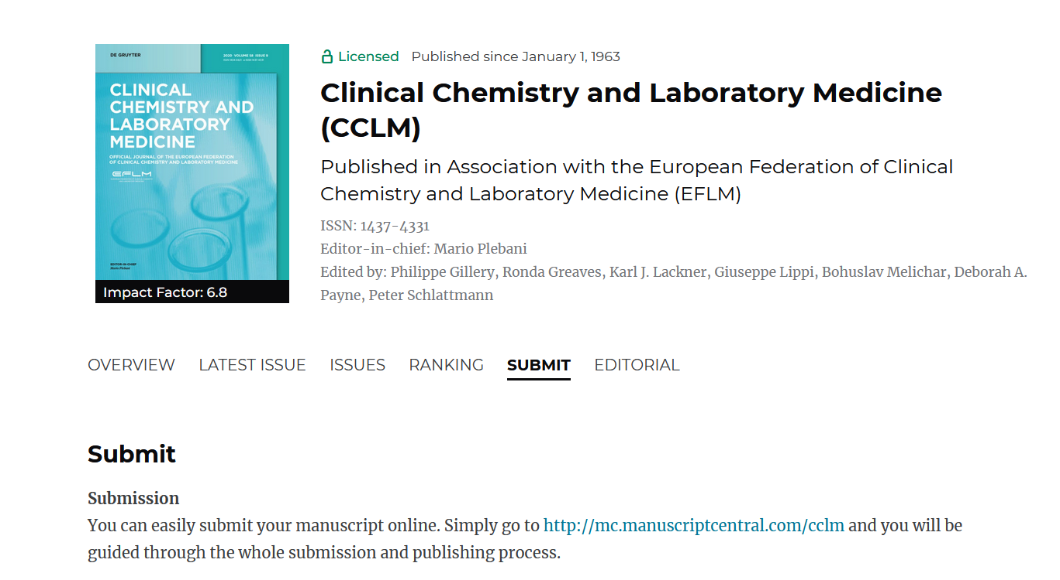
How to submit?
You can easily submit your manuscript online. Simply go to the journal webpage – you will be moved to the submission system page (ScholarOne ManuscriptsTM)

Slide 14
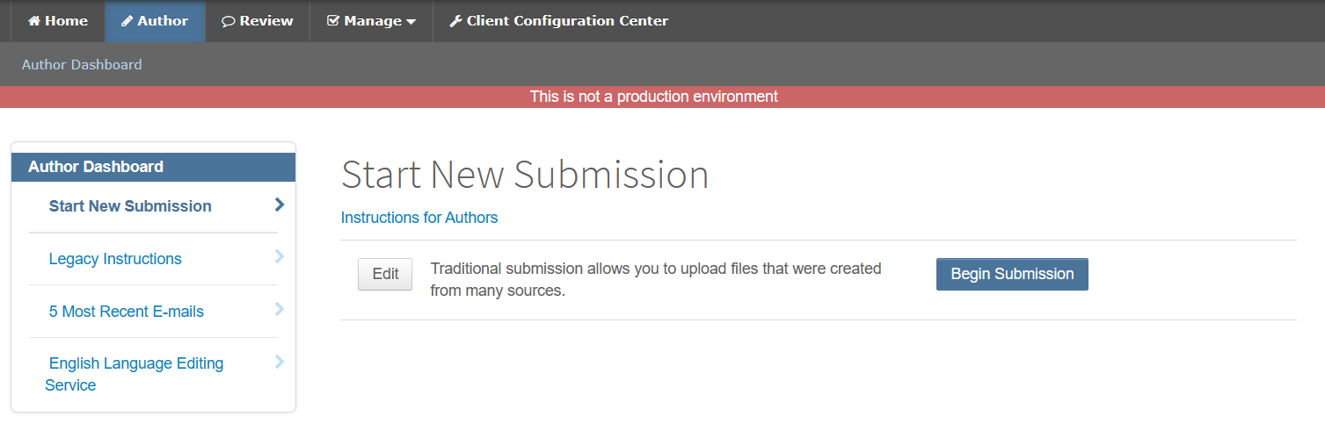
New submission
It would be important to follow the journal instructions for authors in order to prepare the submission in a required form

Slide 15
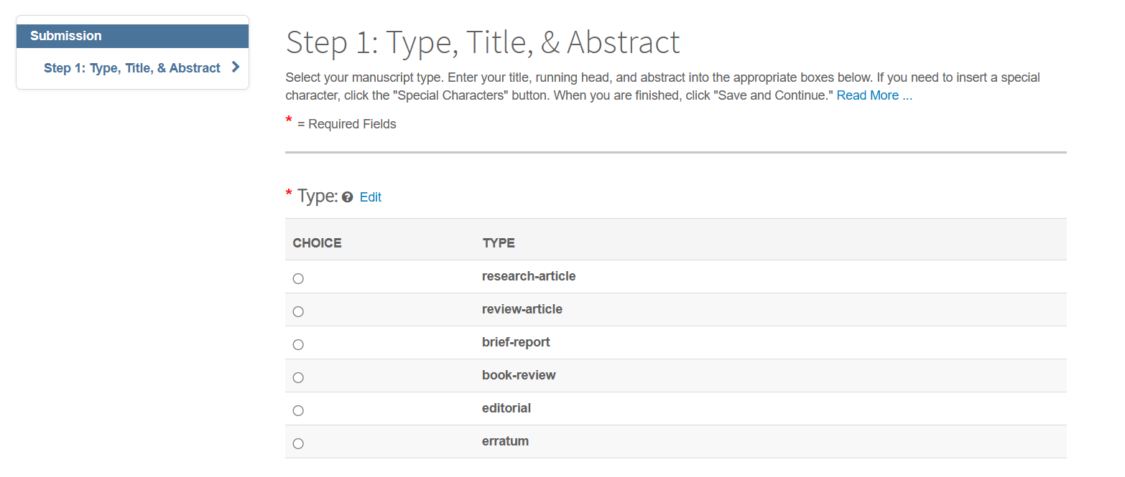
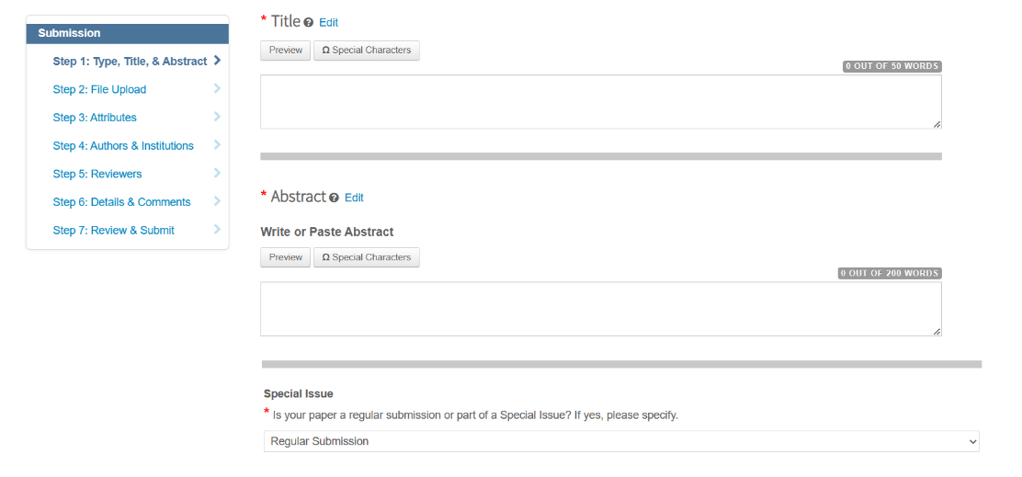
Basic information about the submission
Please deliver basic information about your submission like article type, working title and informative abstract
Where relevant indicate special issue assignment.

Slide 16
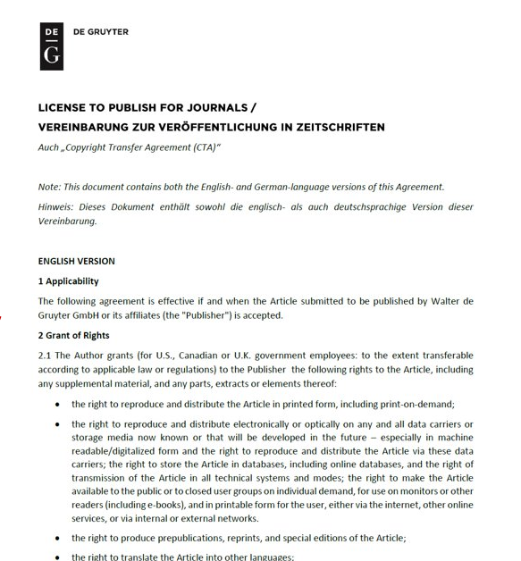
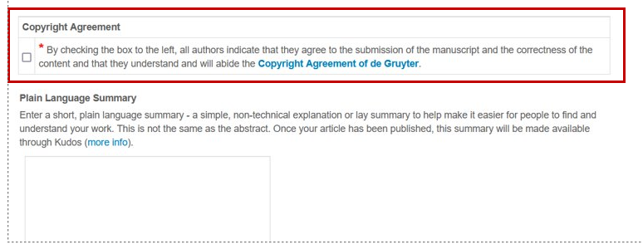
Copyright agreement
Read the License to publish for journals and indicate that you agree to the terms and conditions

Slide 17
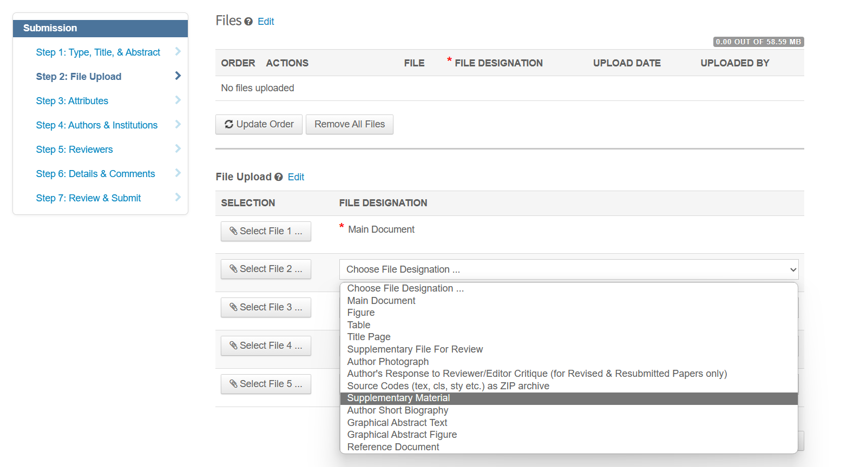
Manuscript upload
Apart from the manuscript, you might need to upload additional files

Slide 18
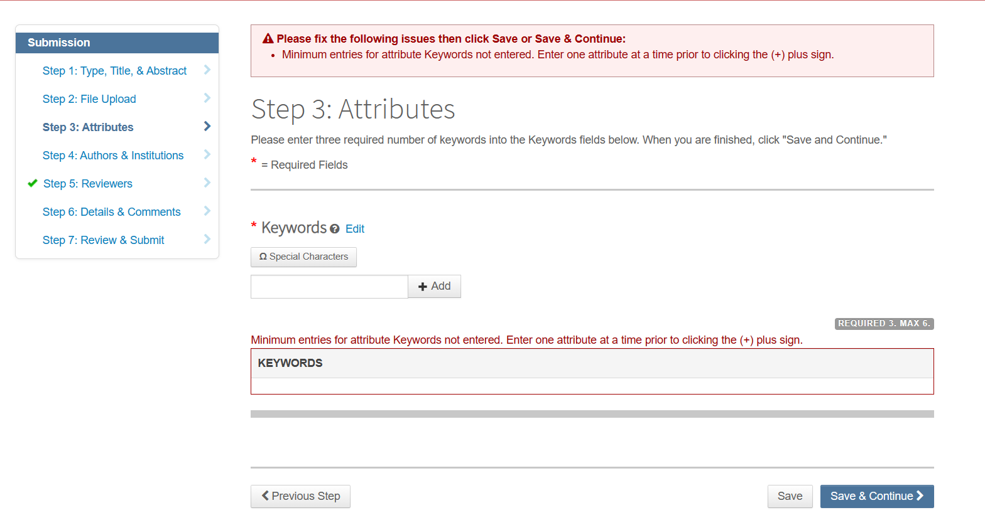
Additional information
Please add a minimum number of required keywords – that will be necessary for us to be able to provide you with a quality and relevant peer-review process

Slide 19
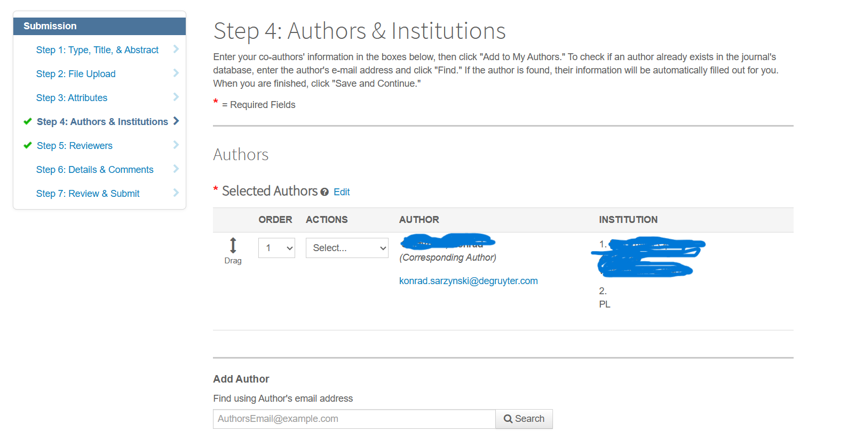
Article submission in a nutshell
Please provide your email address in the institutional domain – that will be important for the future recognition of the funding eligibility

Slide 20
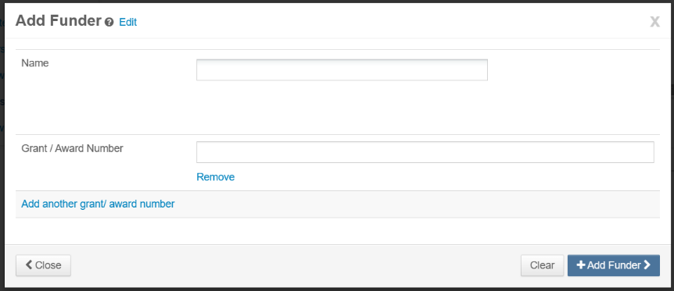
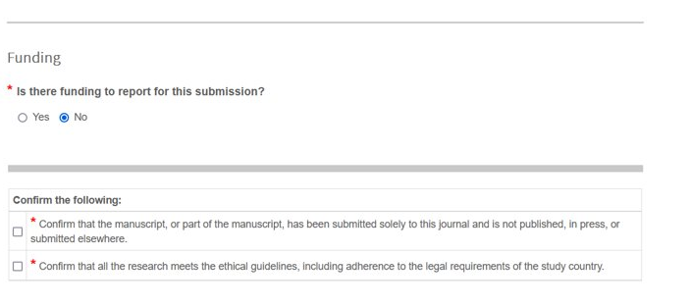
Additional information

Slide 21
Automatic workflow
(touch-free workflow)
AnD
Auto-Approvals

Slide 22
Overwiew of author touchfree workflow
Step 1: The article is accepted for publication
Step 2: The institution is notified
Step 3: The funding is automatically approved
Step 4: The author is notified:
If approved the author is informed the article will be published (Open Access) and the APC covered by his institution.
If denied (Hybrid), the author is informed that his article will be published behind the paywall unless the author covers the APC himself.
If denied (Pure OA), the author is informed that he needs to pay the APC to get publication for his article.

Slide 23
Article is accepted for publication
An author has an article accepted for publication:
• If metadata matches an existing agreement the author is not contacted.
• Metadata is based on the agreement information in Rightslink and the article data sent to Rightslink by the publisher (the corresponding author’s Ringgold ID or email domain).

Slide 24
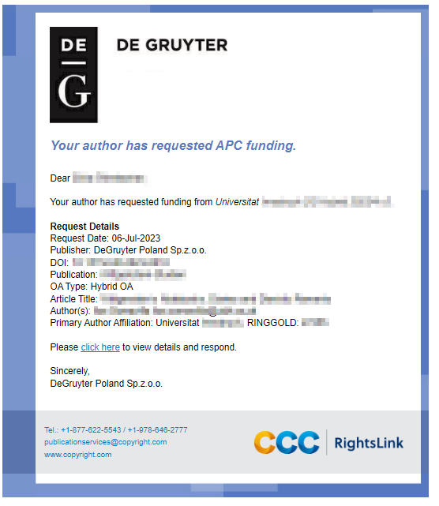
The institution is notified

Slide 25
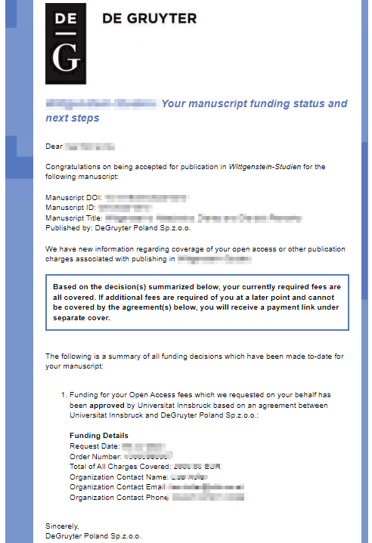
The author is notified (approval)

Slide 26
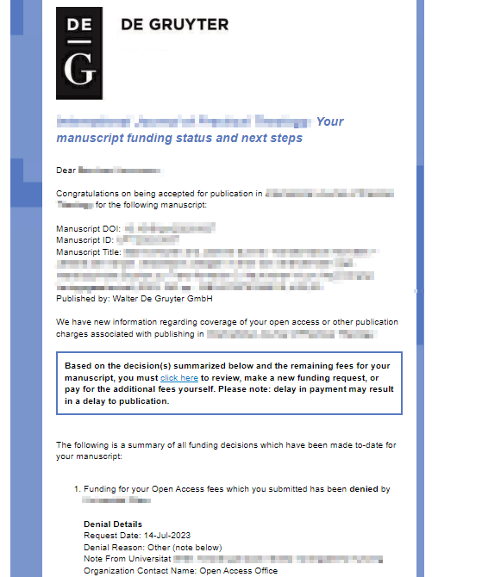
The author is notified (denial)

